Slide 1
PRIMS ALGORITHM

Slide 2
What is prims algorithm?
Prim's algorithm to find minimum cost spanning tree (as Kruskal's algorithm) uses the greedy approach. Prim's algorithm shares a similarity with the shortest path first algorithms.
Prim's algorithm, in contrast with Kruskal's algorithm, treats the nodes as a single tree and keeps on adding new nodes to the spanning tree from the given graph.
The time required by algorithm Prim is O(n^2) where n is number of vertices in graph G. Each iteration of for loop takes O(n) time. So the total time is O(n^2). If we store nodes not yet included in tree as a red-black tree then algorithm takes O(log n) time.

Slide 3
Prims Method is preffered when-
The graph is dense.
There are large number of edges in the graph like E = O(V²)

Slide 4
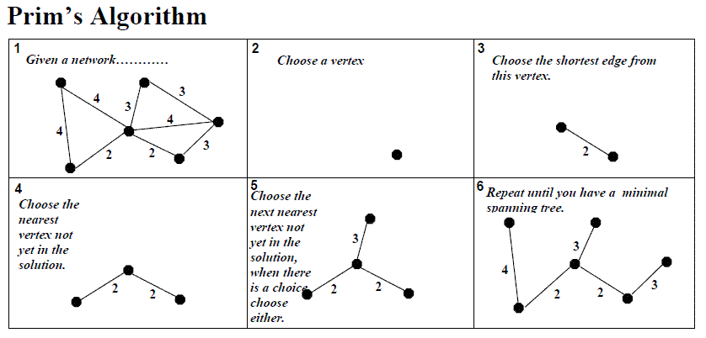

Slide 5
Algorithm--
Create a set mstSet that keeps track of vertices already included in MST.
Assign a key value to all vertices in the input graph. Initialize all key values as INFINITE. Assign key value as 0 for the first vertex so that it is picked first.
While mstSet doesn’t include all vertices ….a) Pick a vertex u which is not there in mstSet and has minimum key value. ….b) Include u to mstSet. ….c) Update key value of all adjacent vertices of u.
To update the key values, iterate through all adjacent vertices. For every adjacent vertex v, if weight of edge u-v is less than the previous key value of v, update the key value as weight of u-v

Slide 6
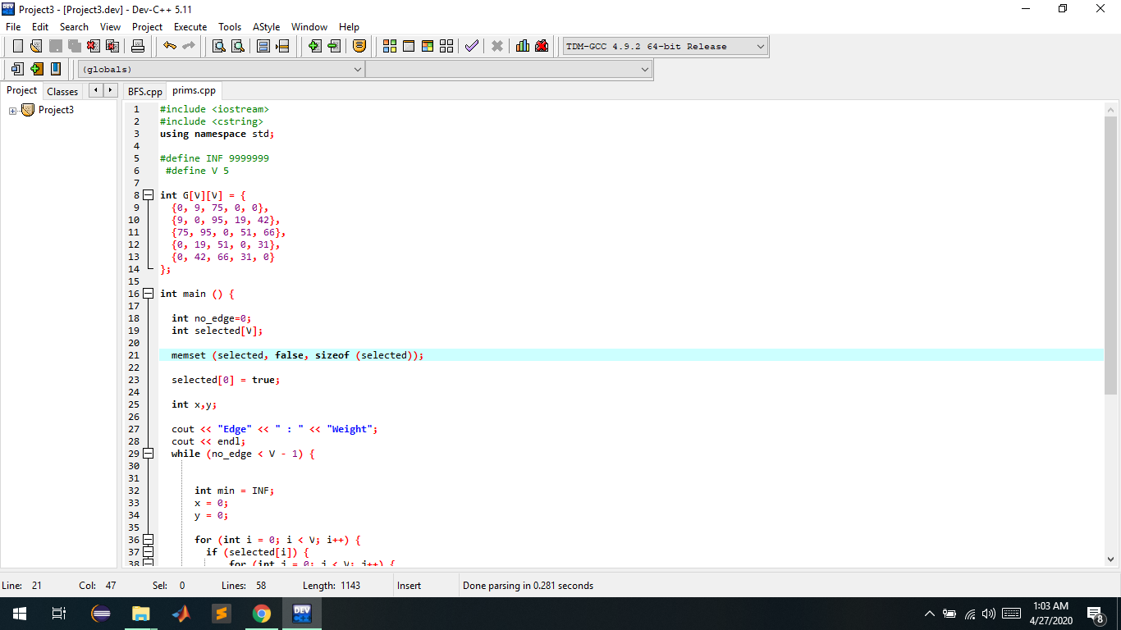
CODE

Slide 7
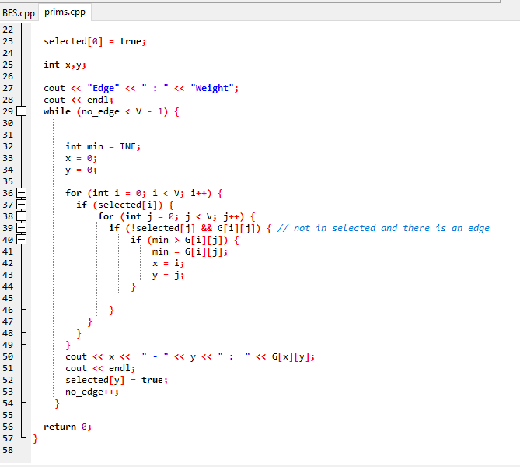

Slide 8
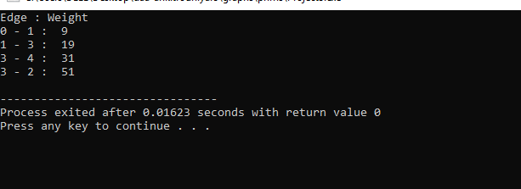
OUTPUT--

